Slide 1
B&W to RGB - Update
Group 35 - James Johnson & Josh Terry
Georgia Institute of Technology
CS x475 - Frank Dellaert

Slide 2
Project Recap
Take black and white photographs using non-RGB gel filters
Using Processing, map image data onto RGB color channels
Allow user input to modify intensity of each color channel
Provide user with novel image rendered in real-time

Slide 3
Steps Taken
Taken B&W and RGB photographs through multiple filters (red, green, blue, cyan, yellow, magenta, orange, purple)
Compiled these images in Photoshop
Observed oddities within these images
Experimented with methods of combining images
Begun coding our program
Planned the rest of our project moving forward

Slide 4
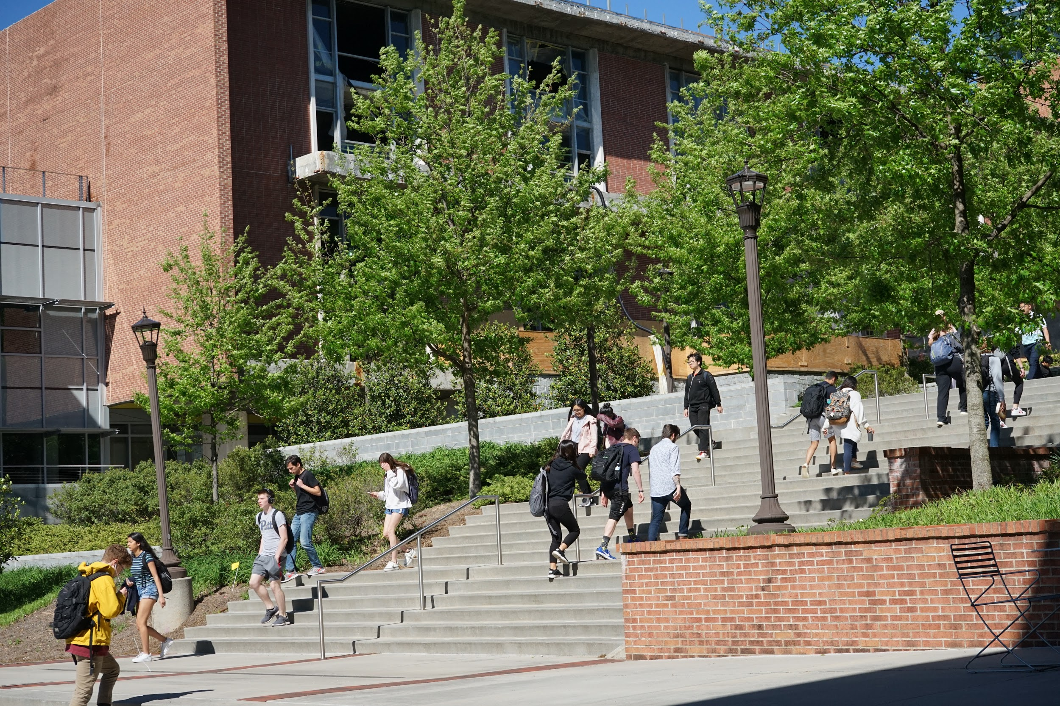
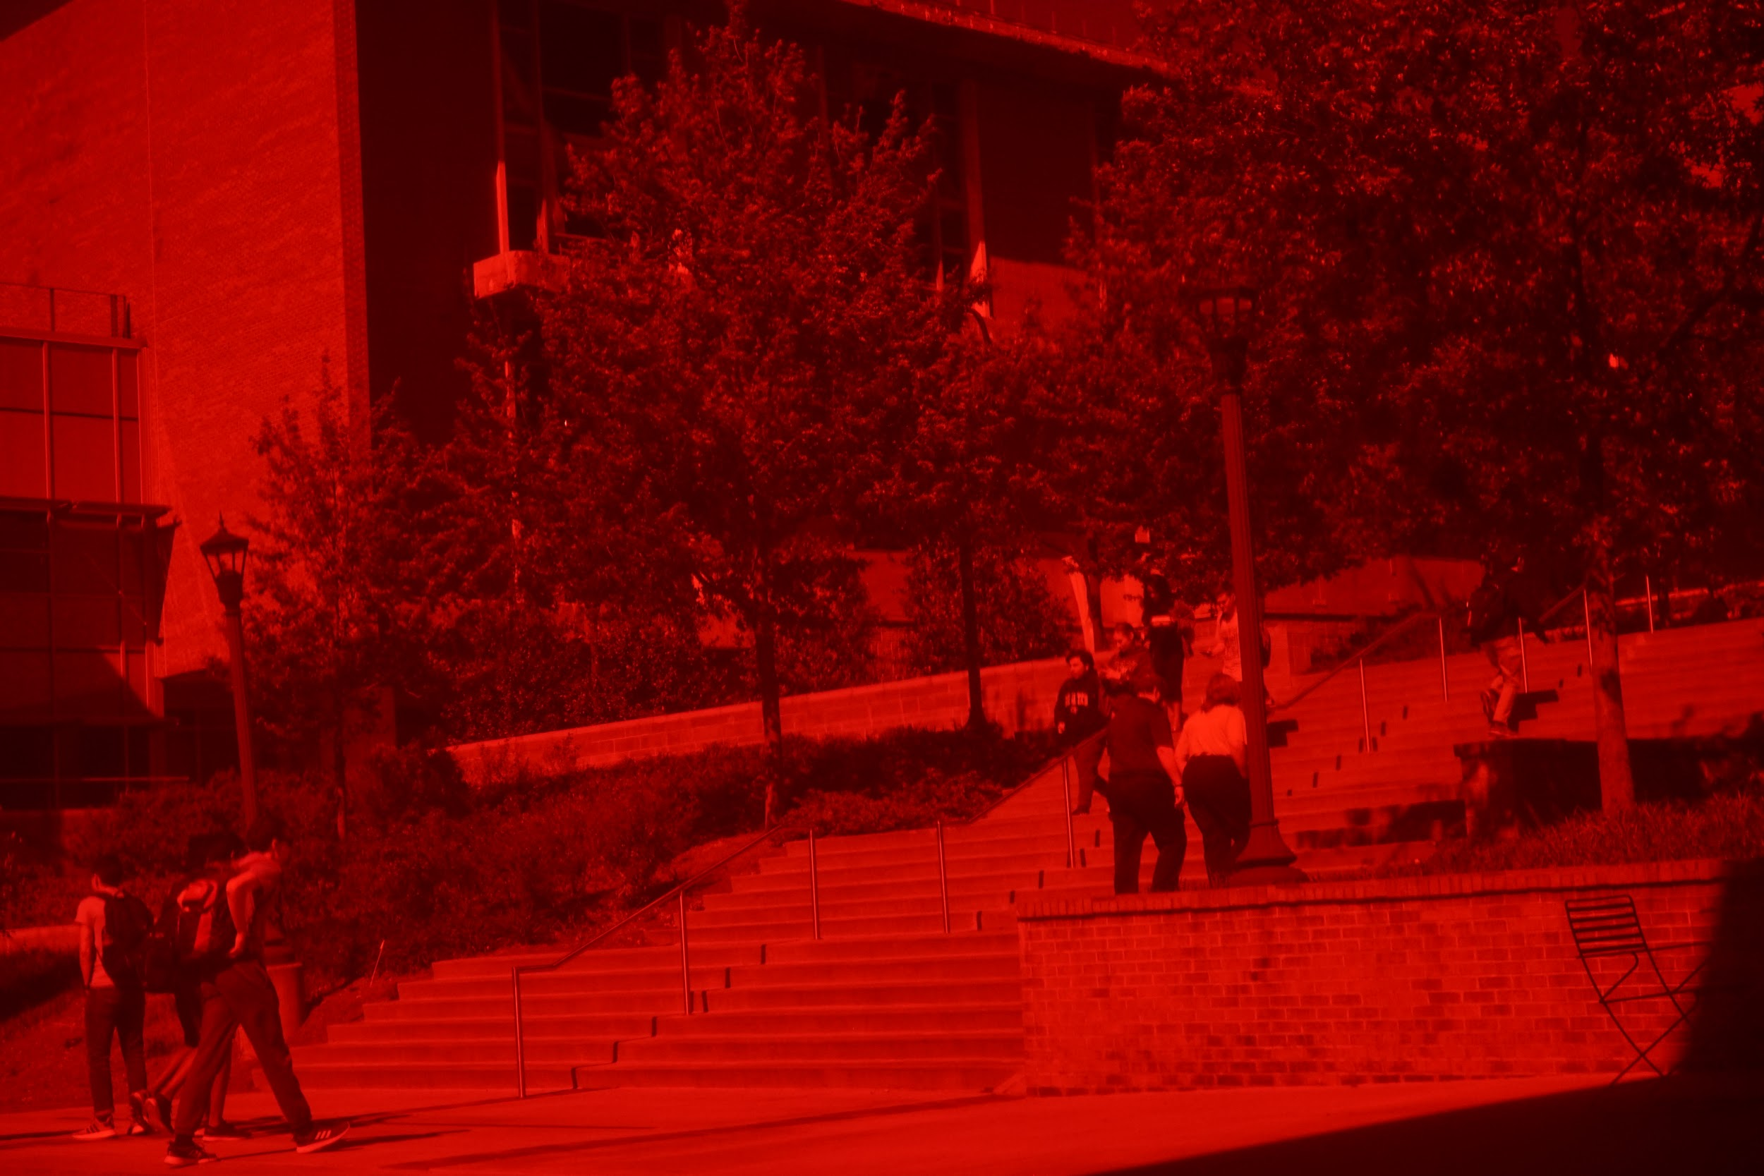
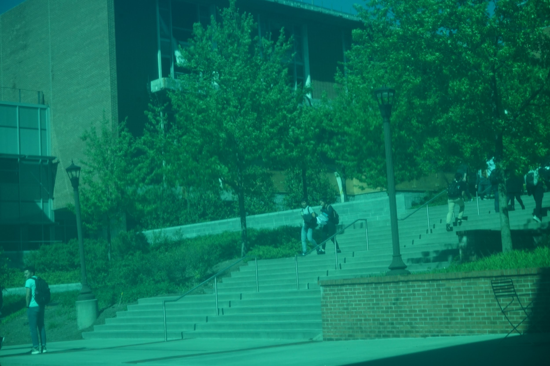
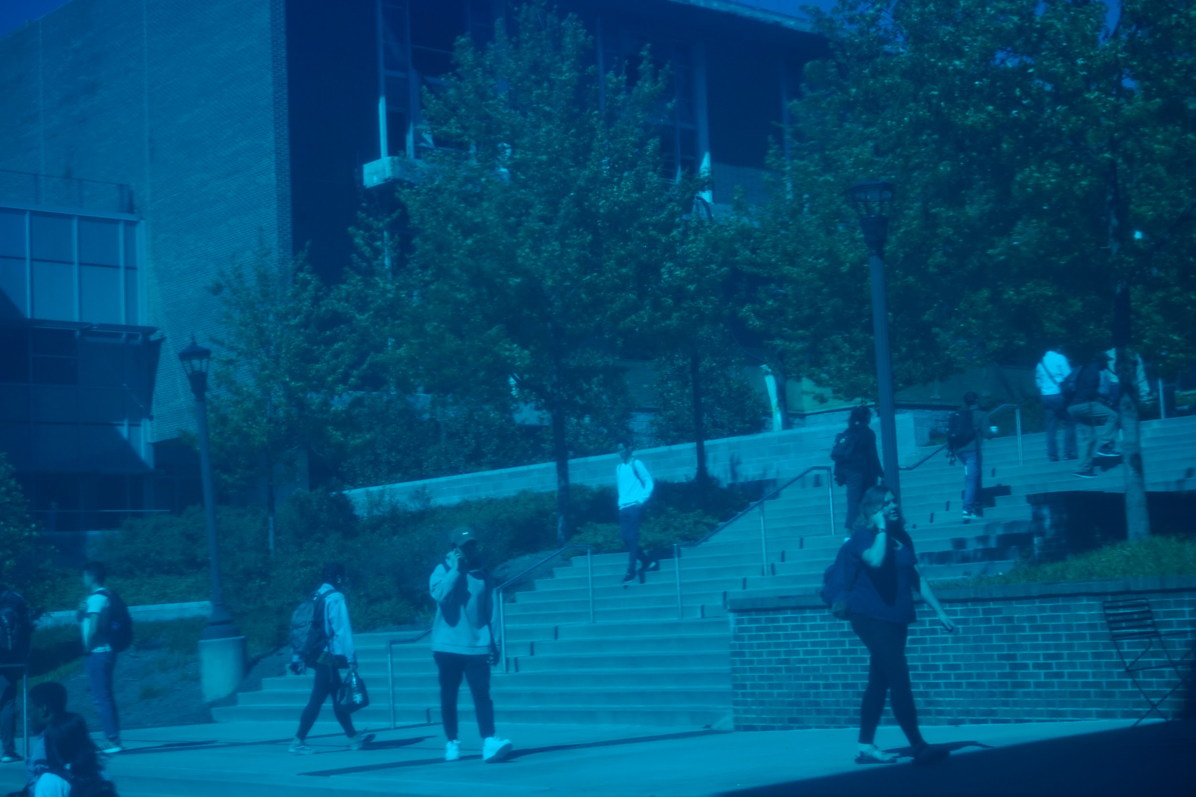
Images: RGB + Dynamic
We first captured RGB images of a dynamic background through RGB color filters to better gauge how to tackle this project.

Slide 5
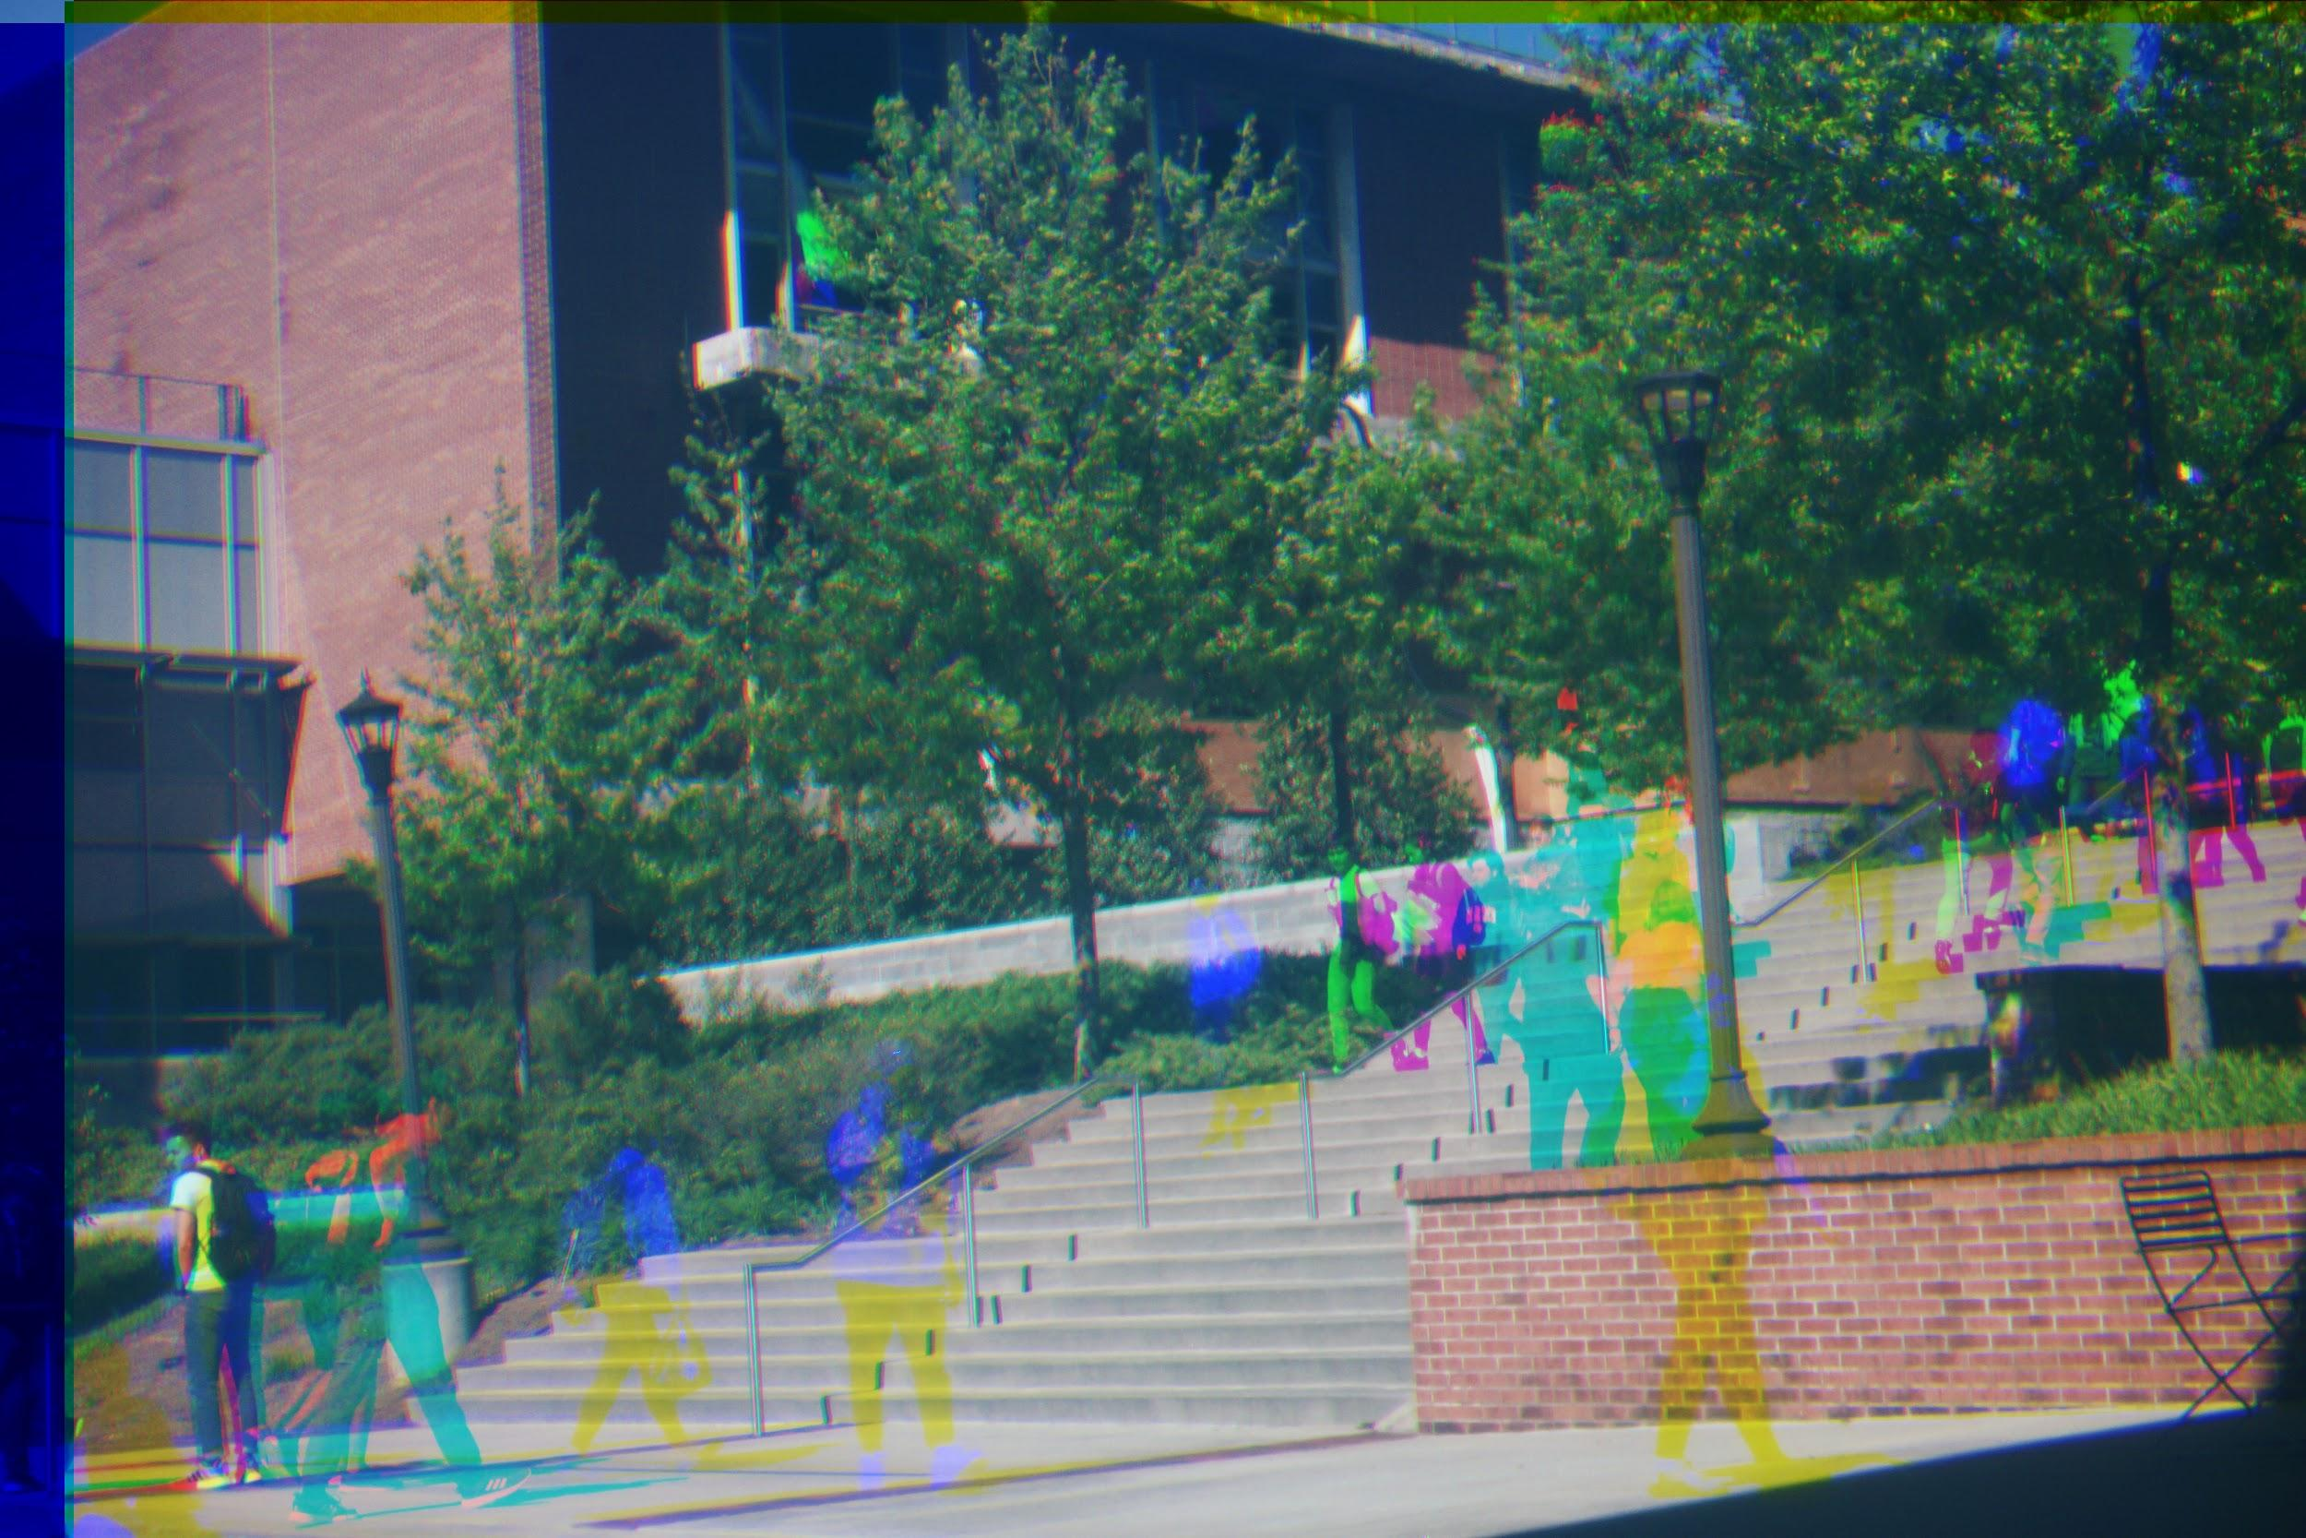
Colorful artifacts
“Washed out” appearance
Misaligned edges

Slide 6
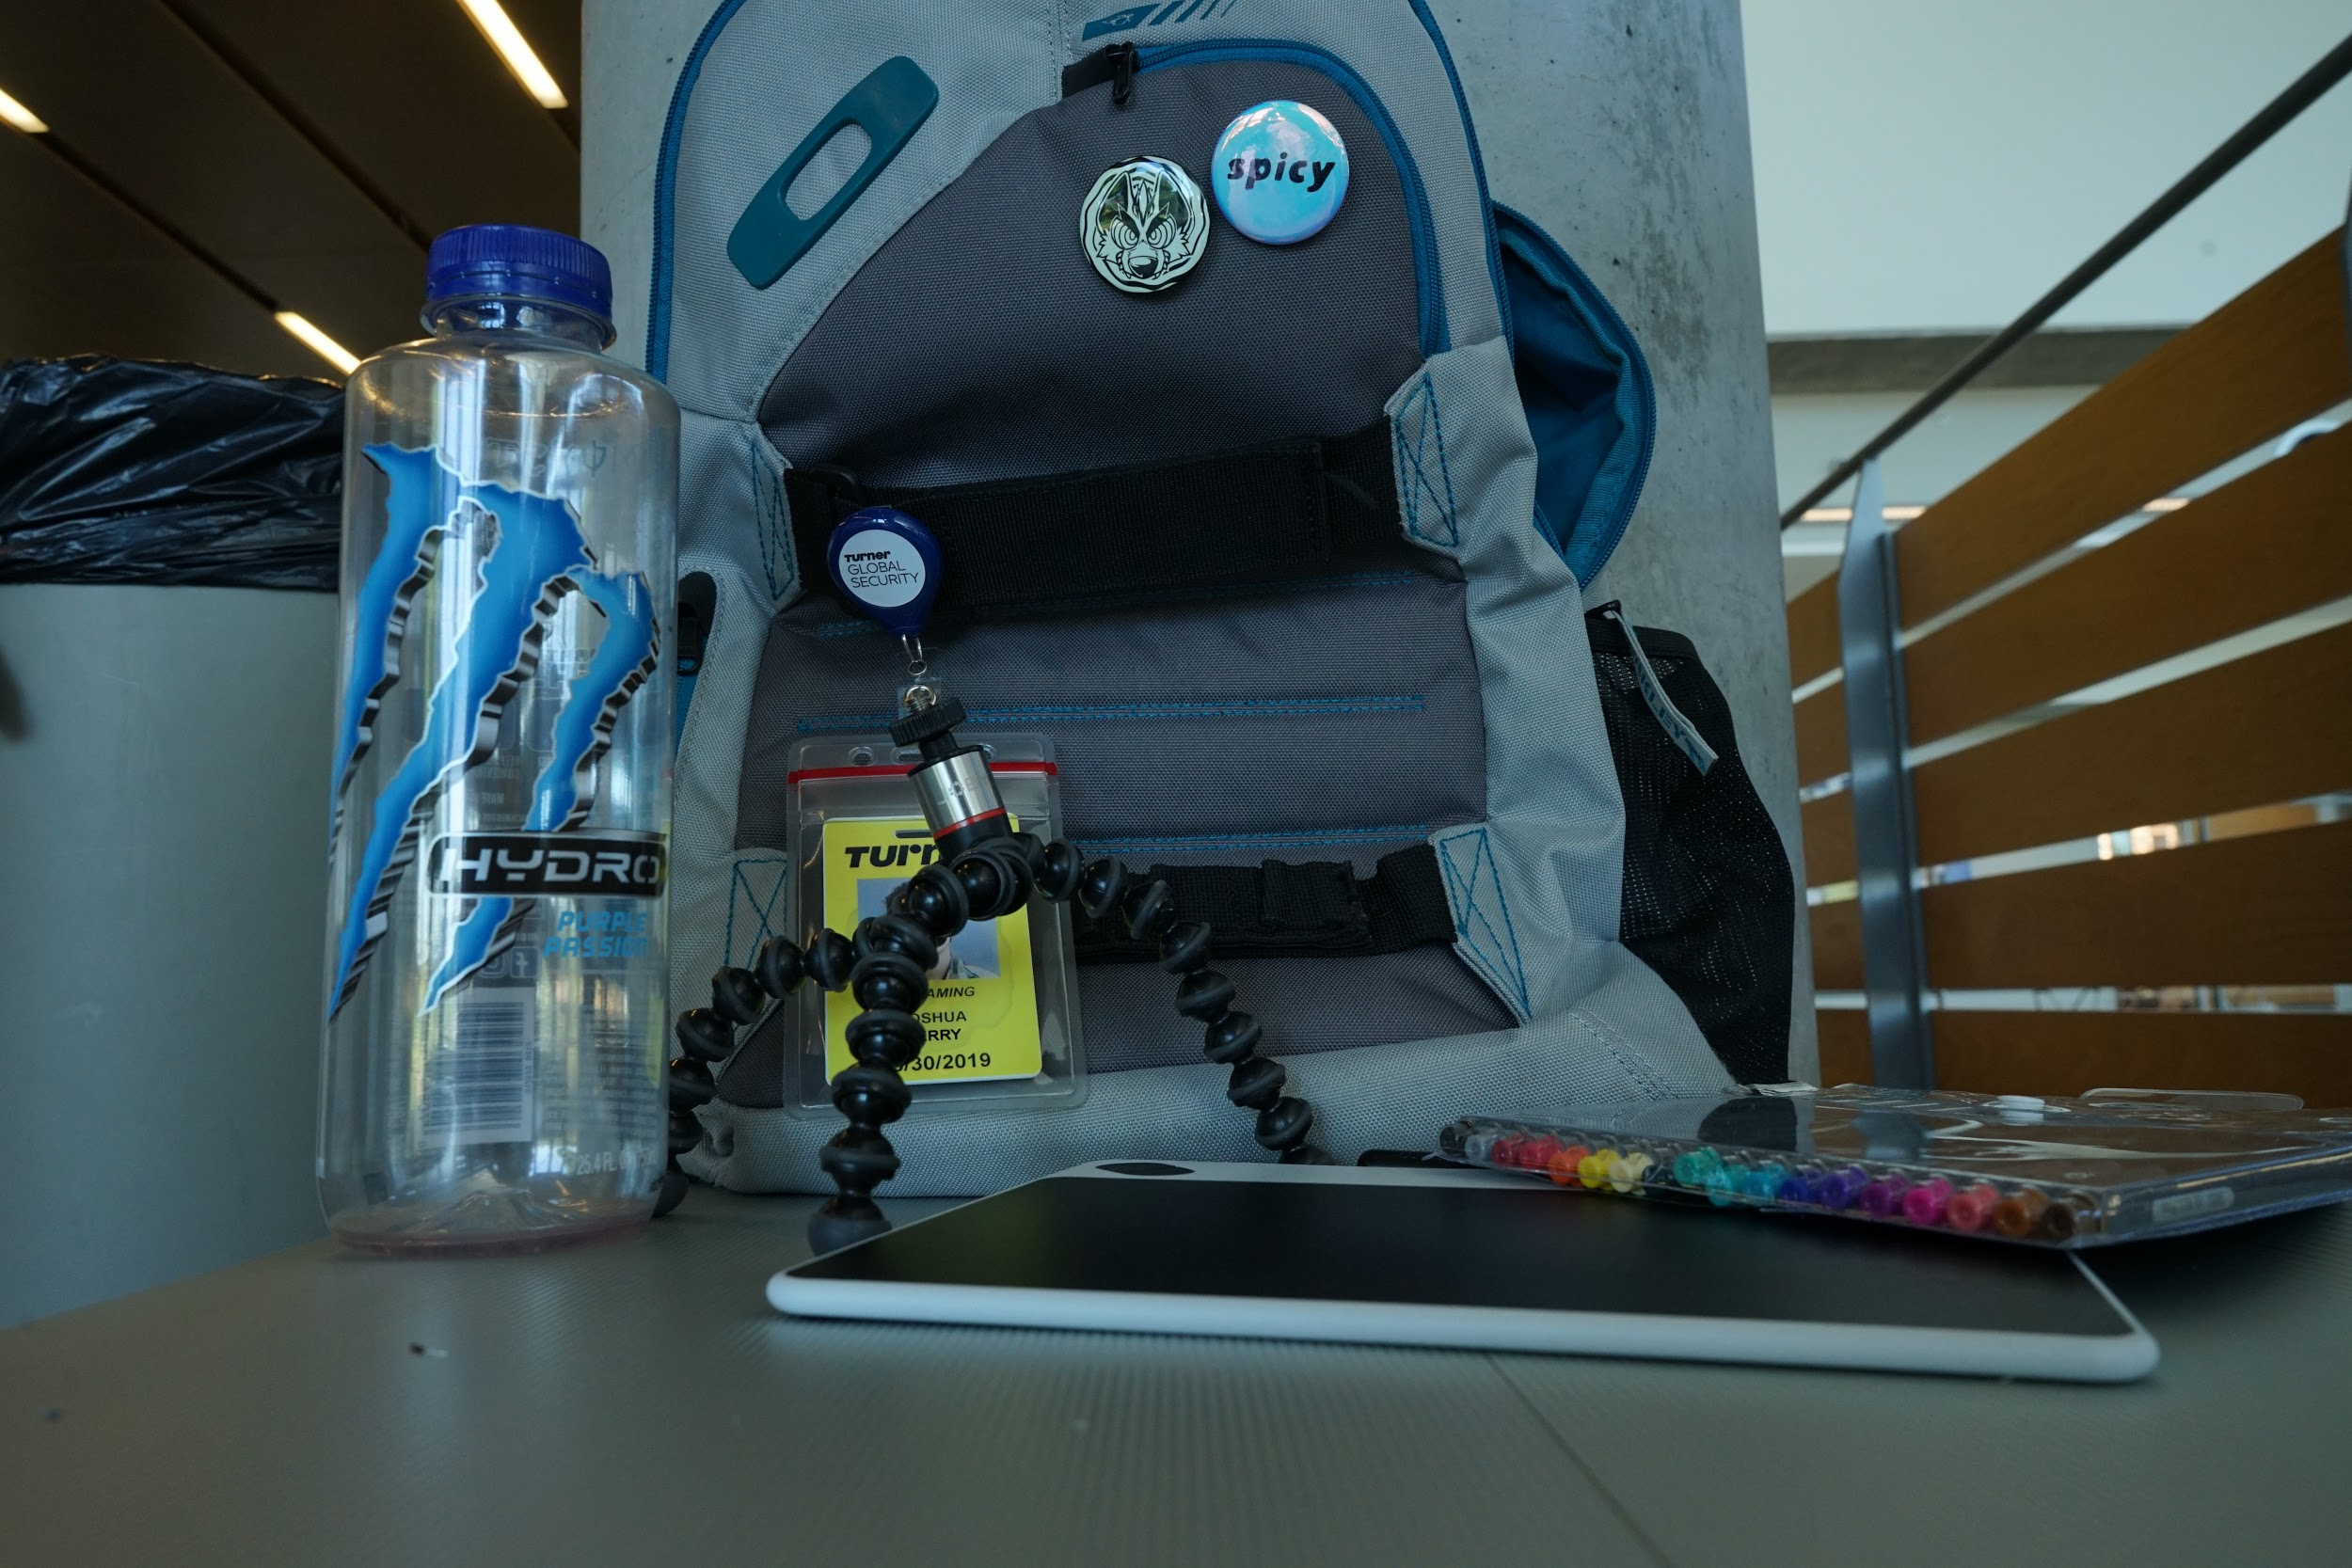
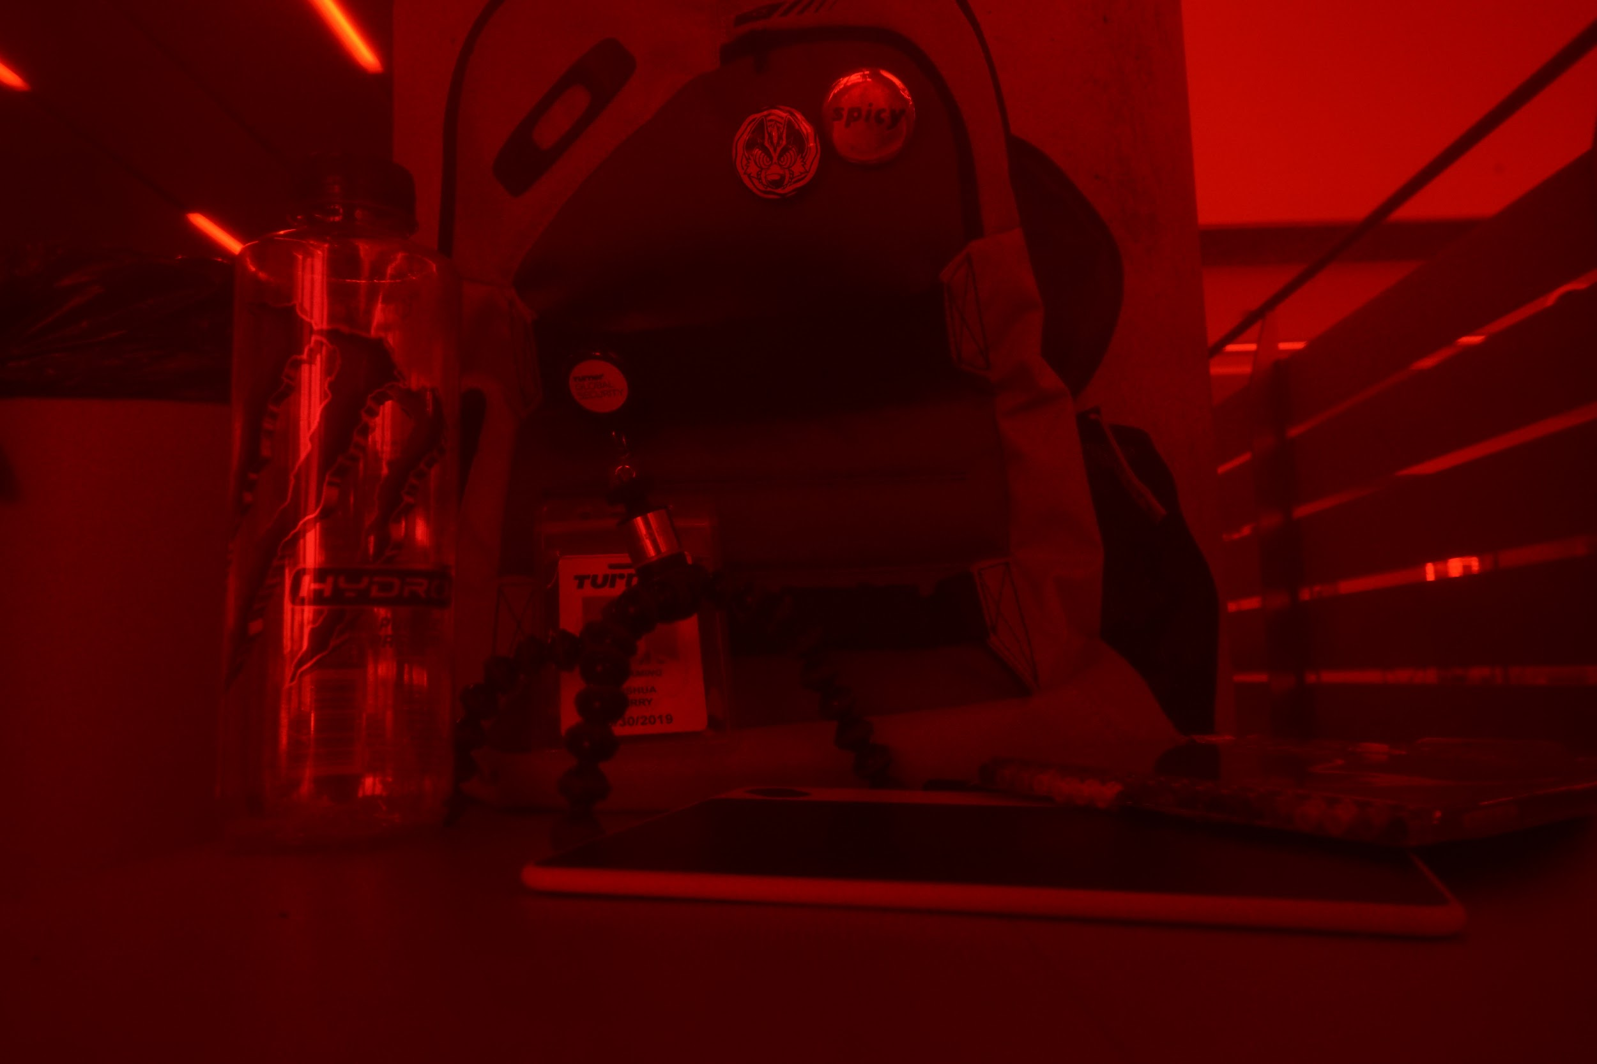
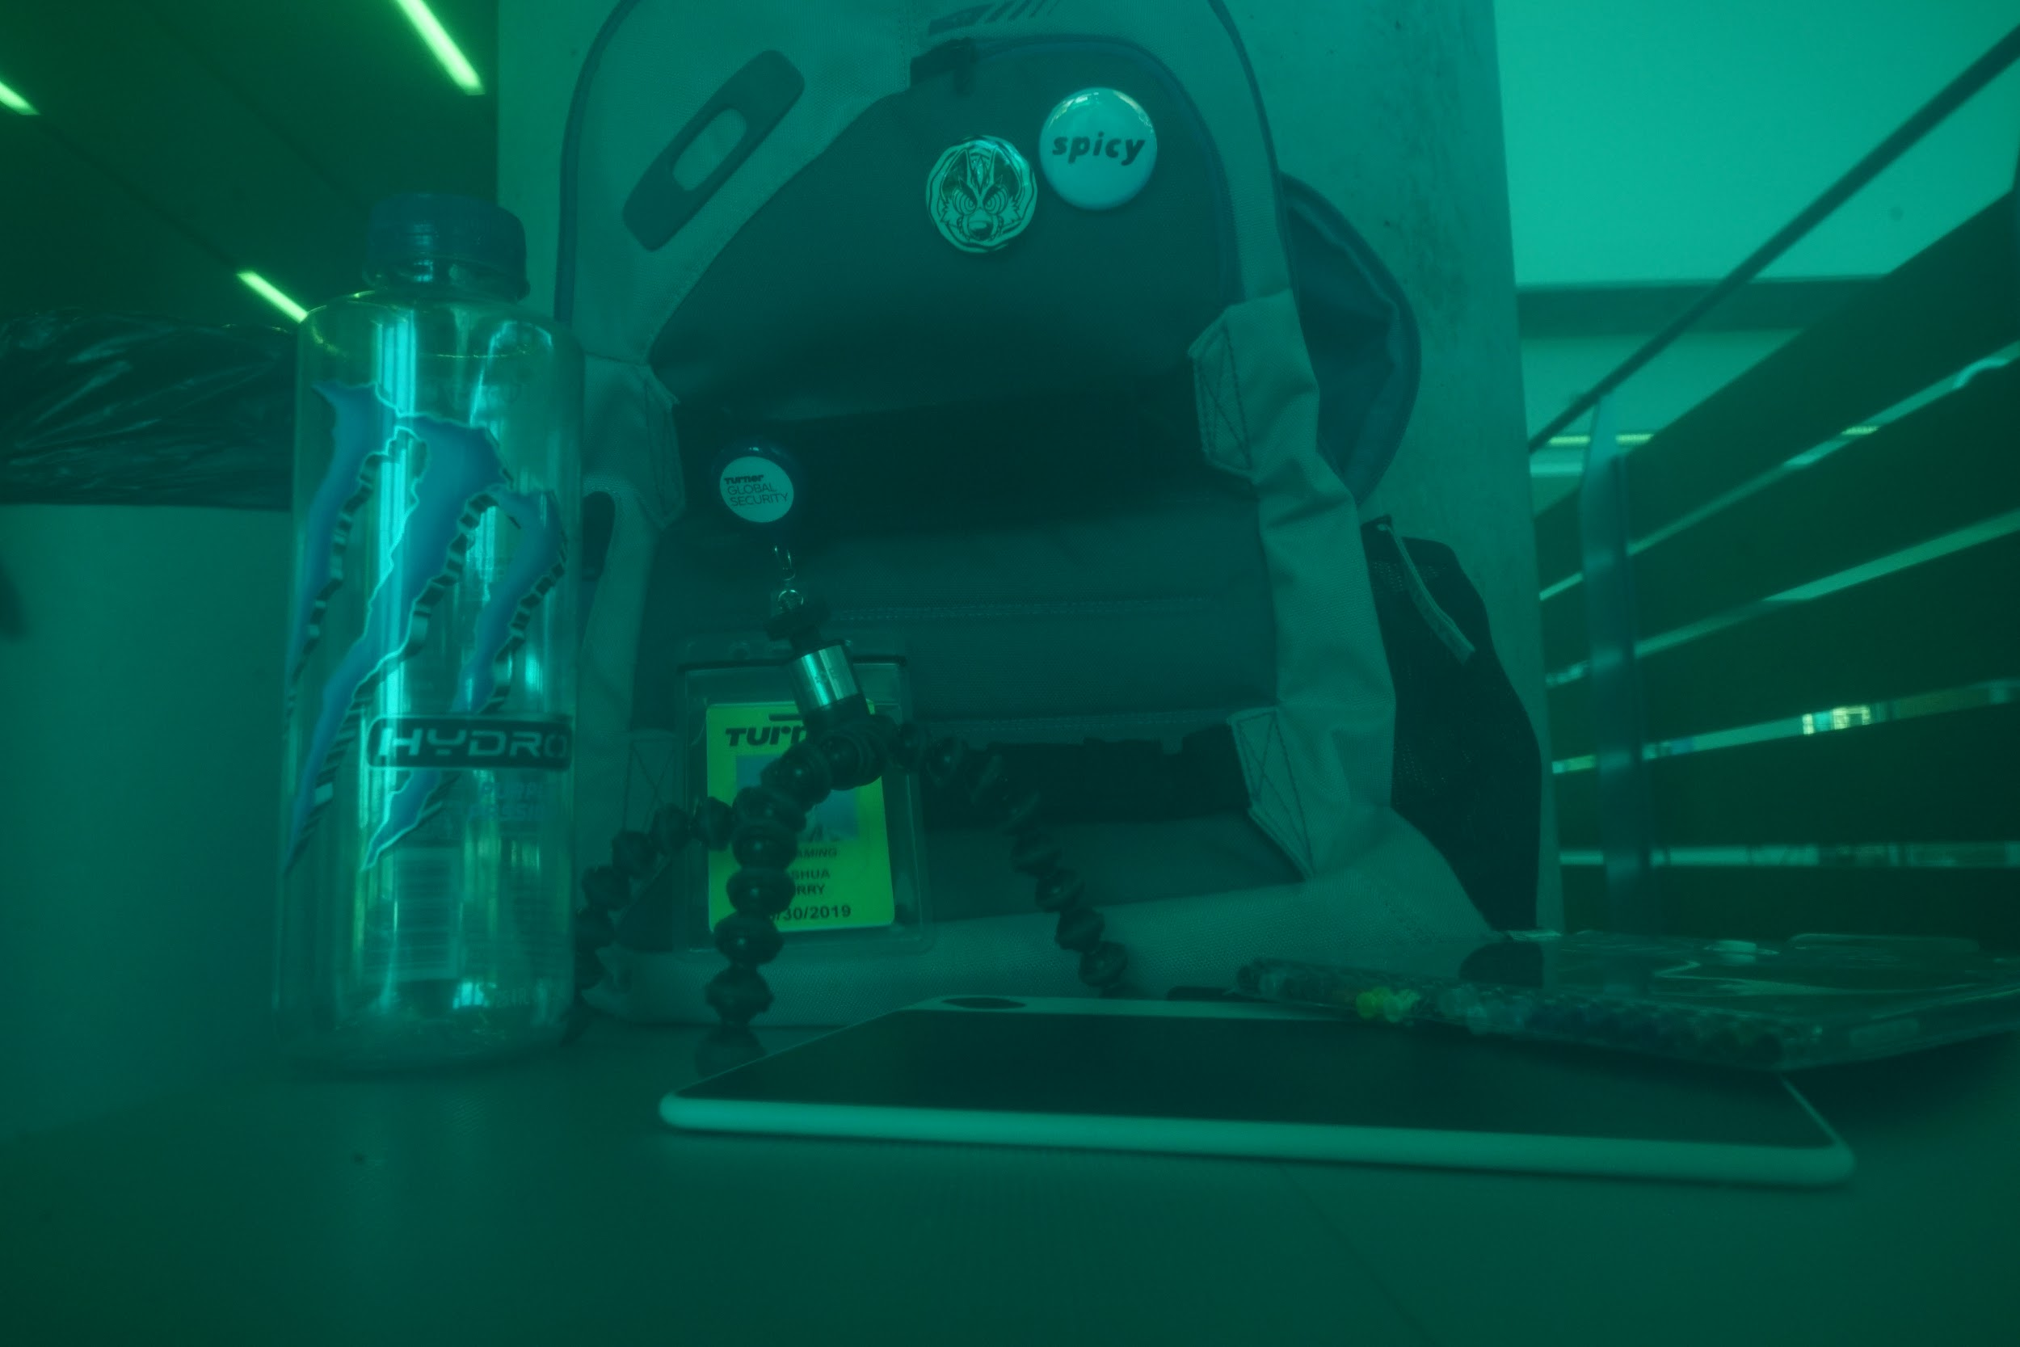
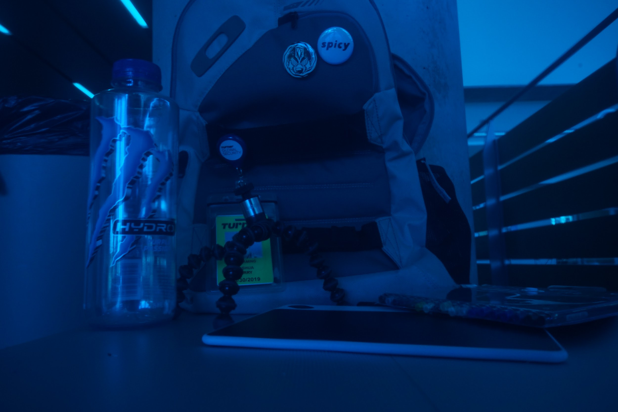
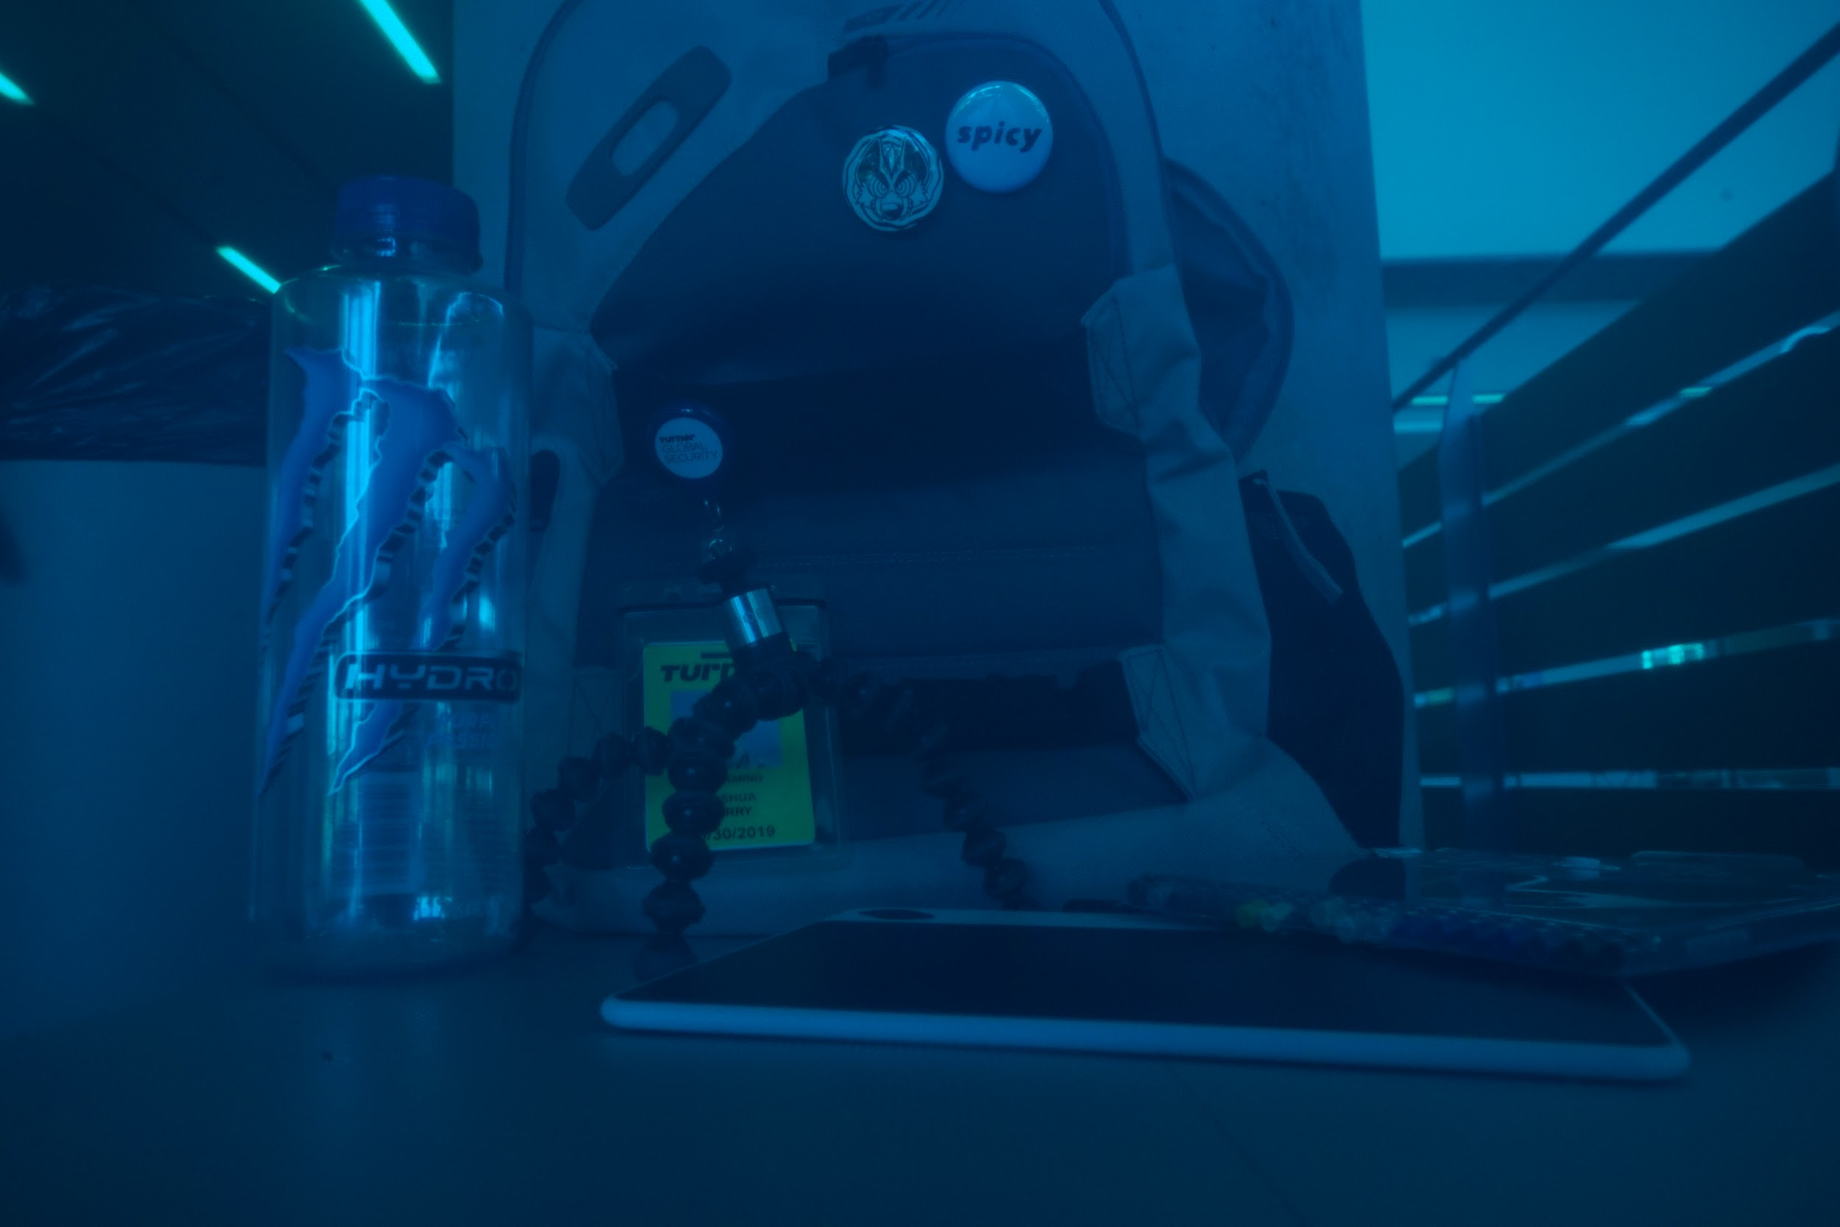
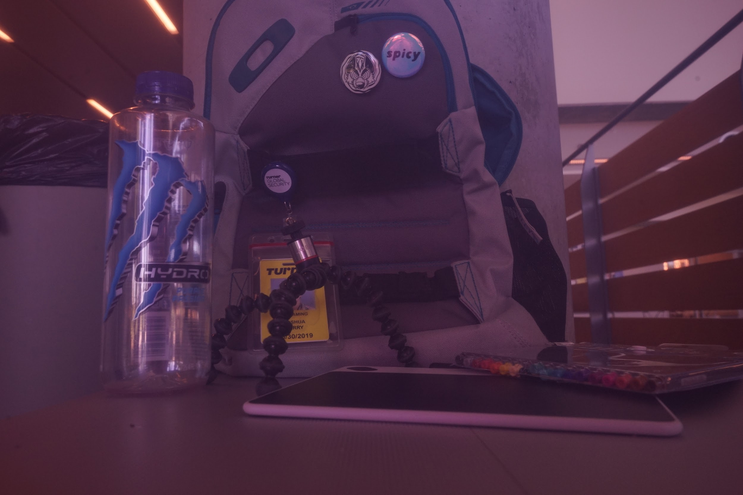
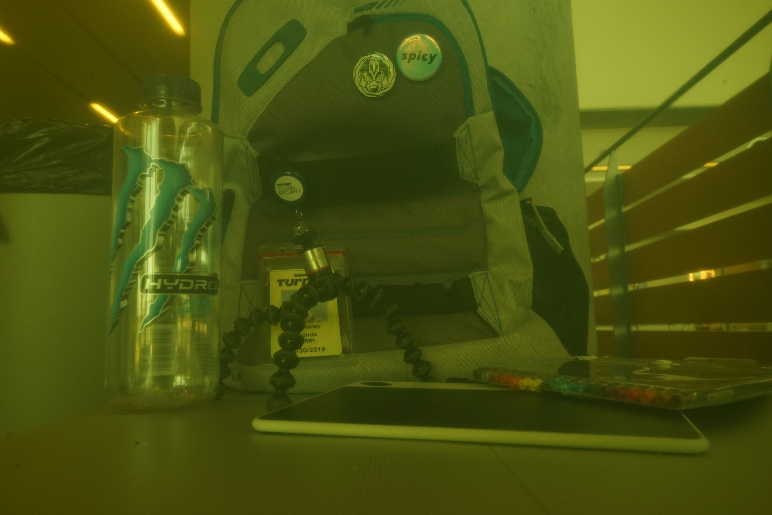
Images: RGB + Static
Next, we captured RGB images through RGB and CMY filters to gain a better understanding of the impact made on images by these colored gel filters.

Slide 7
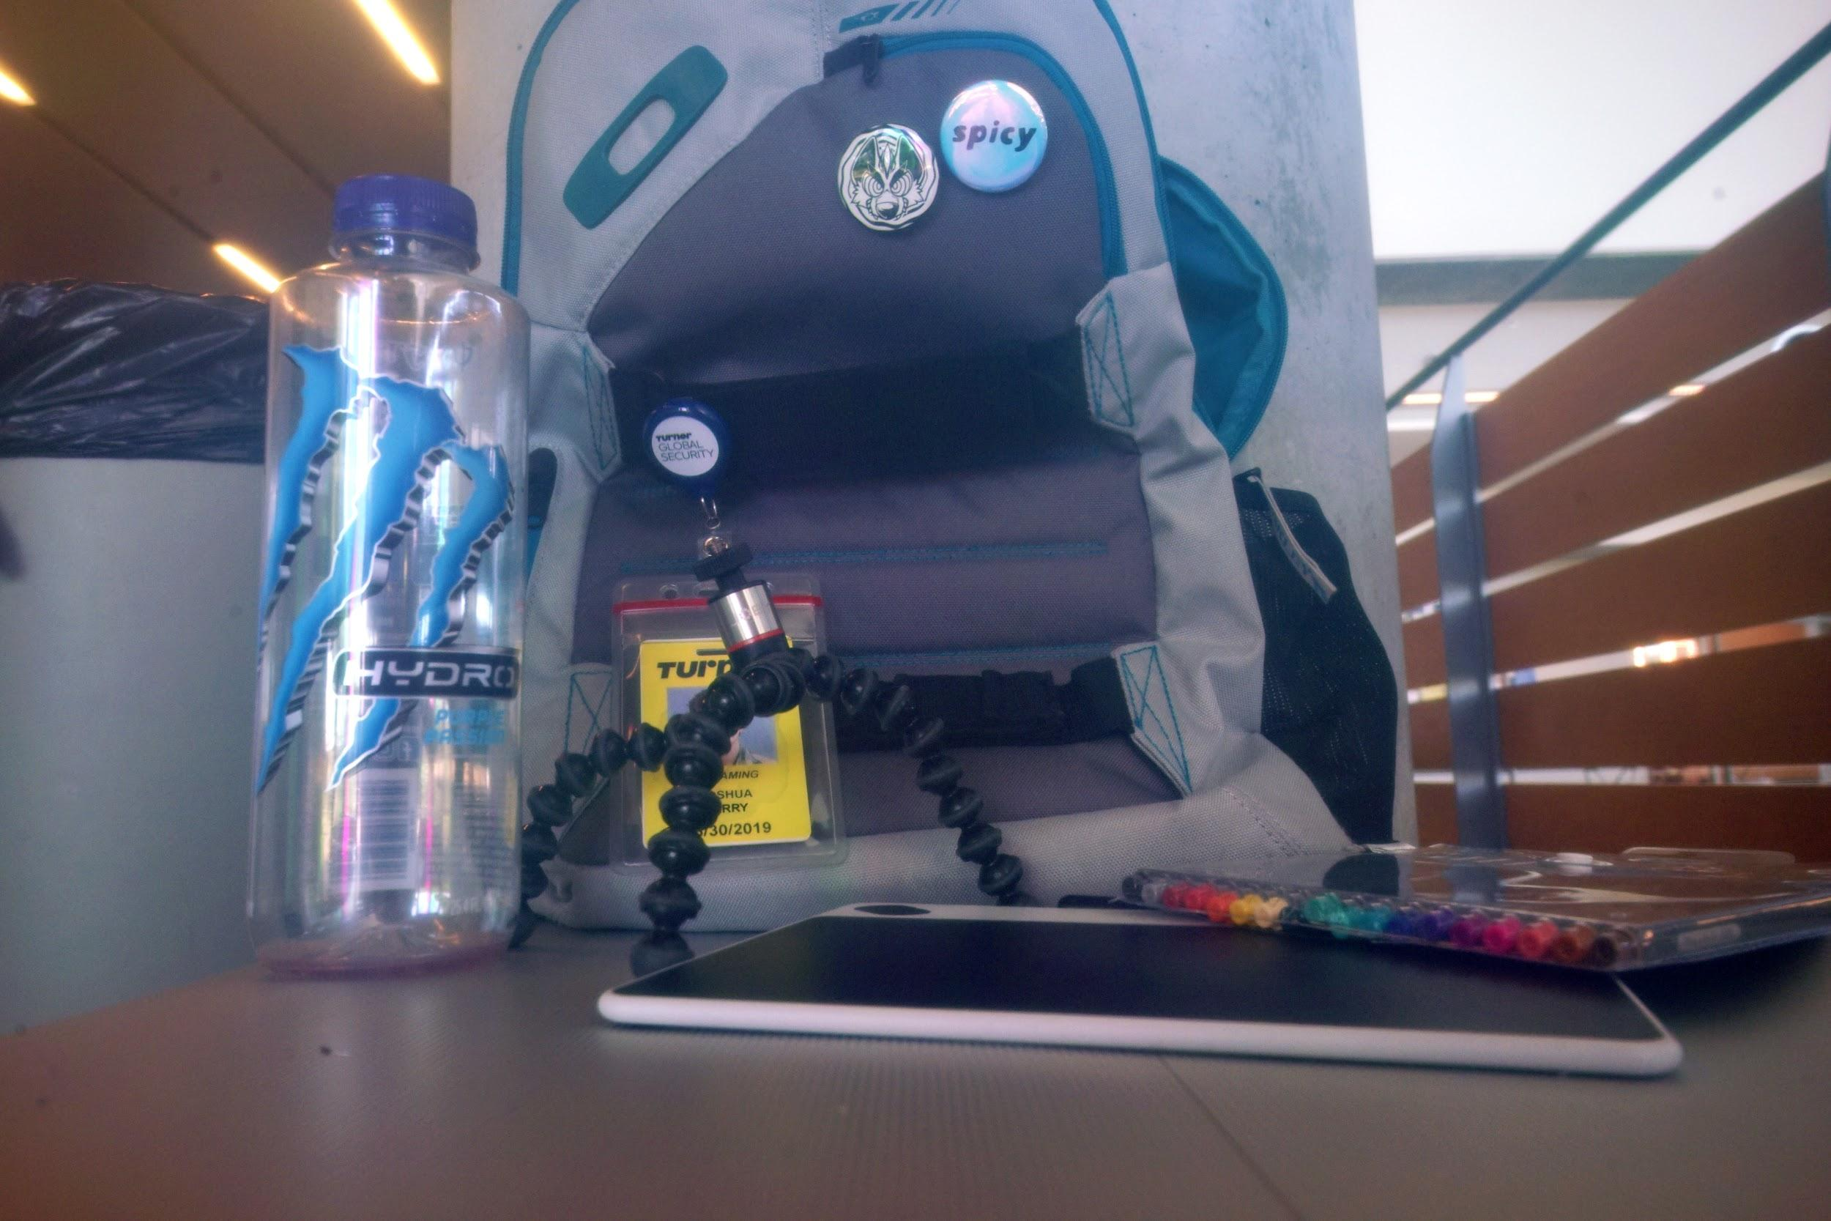
Colorful specular highlights
Depth of Field appears shallower
“Washed out” appearance persists
Misaligned edges persist

Slide 8
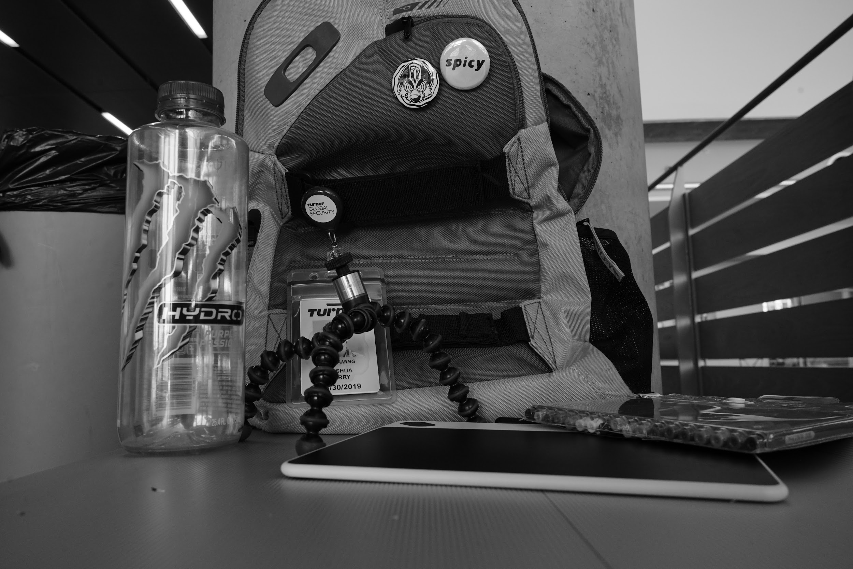
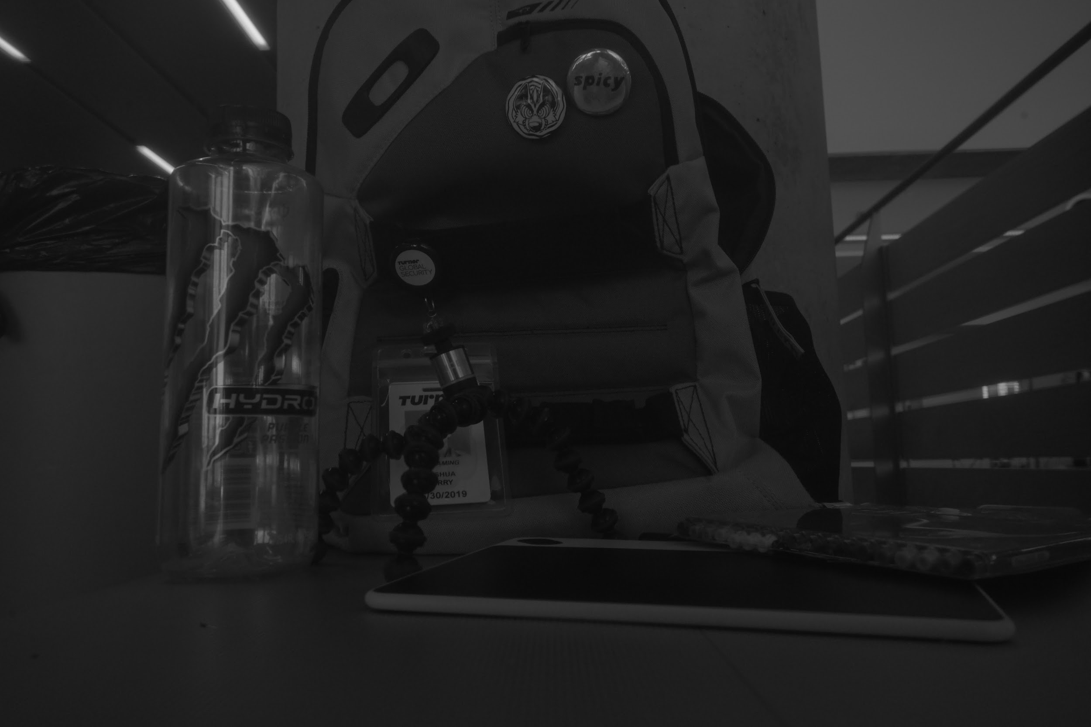
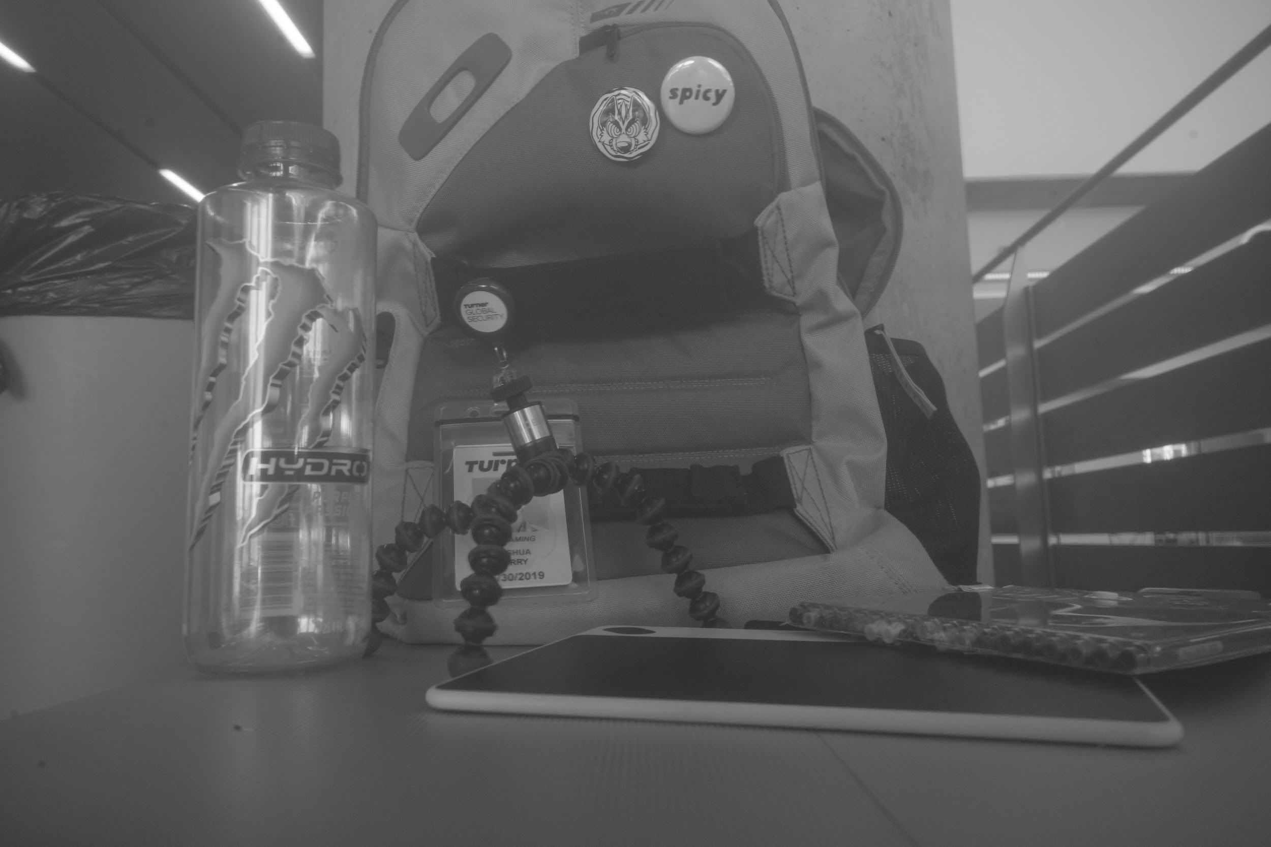
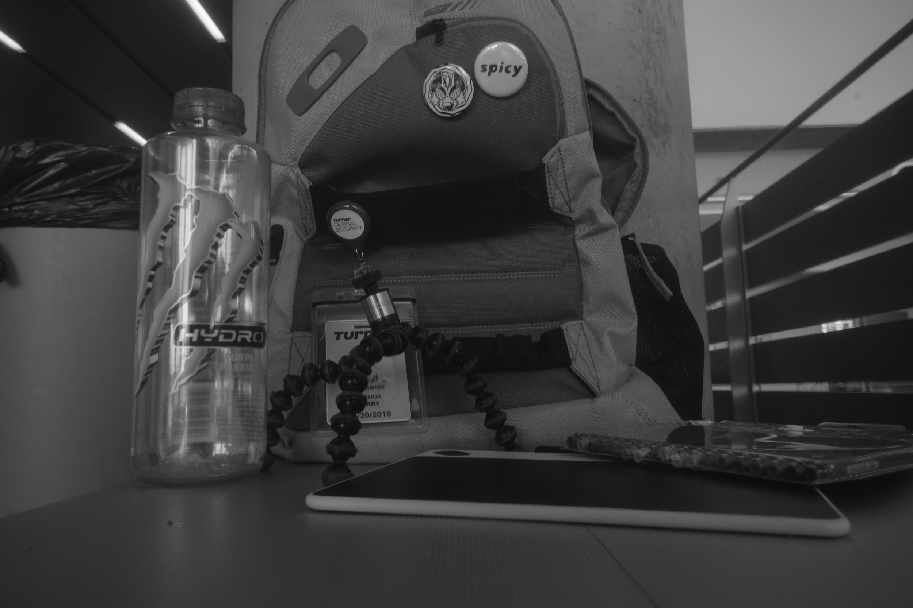
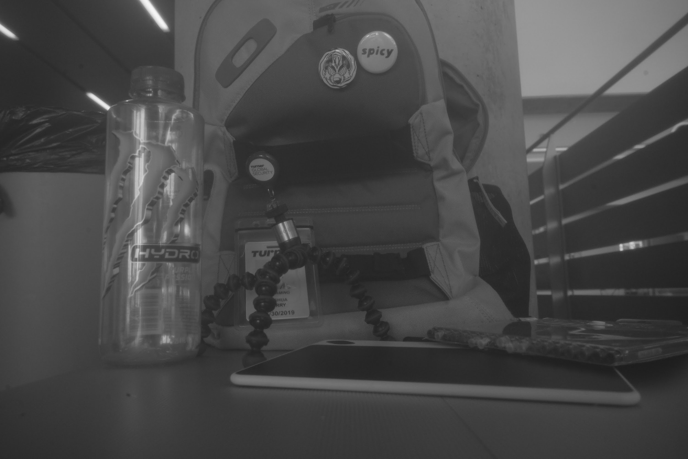
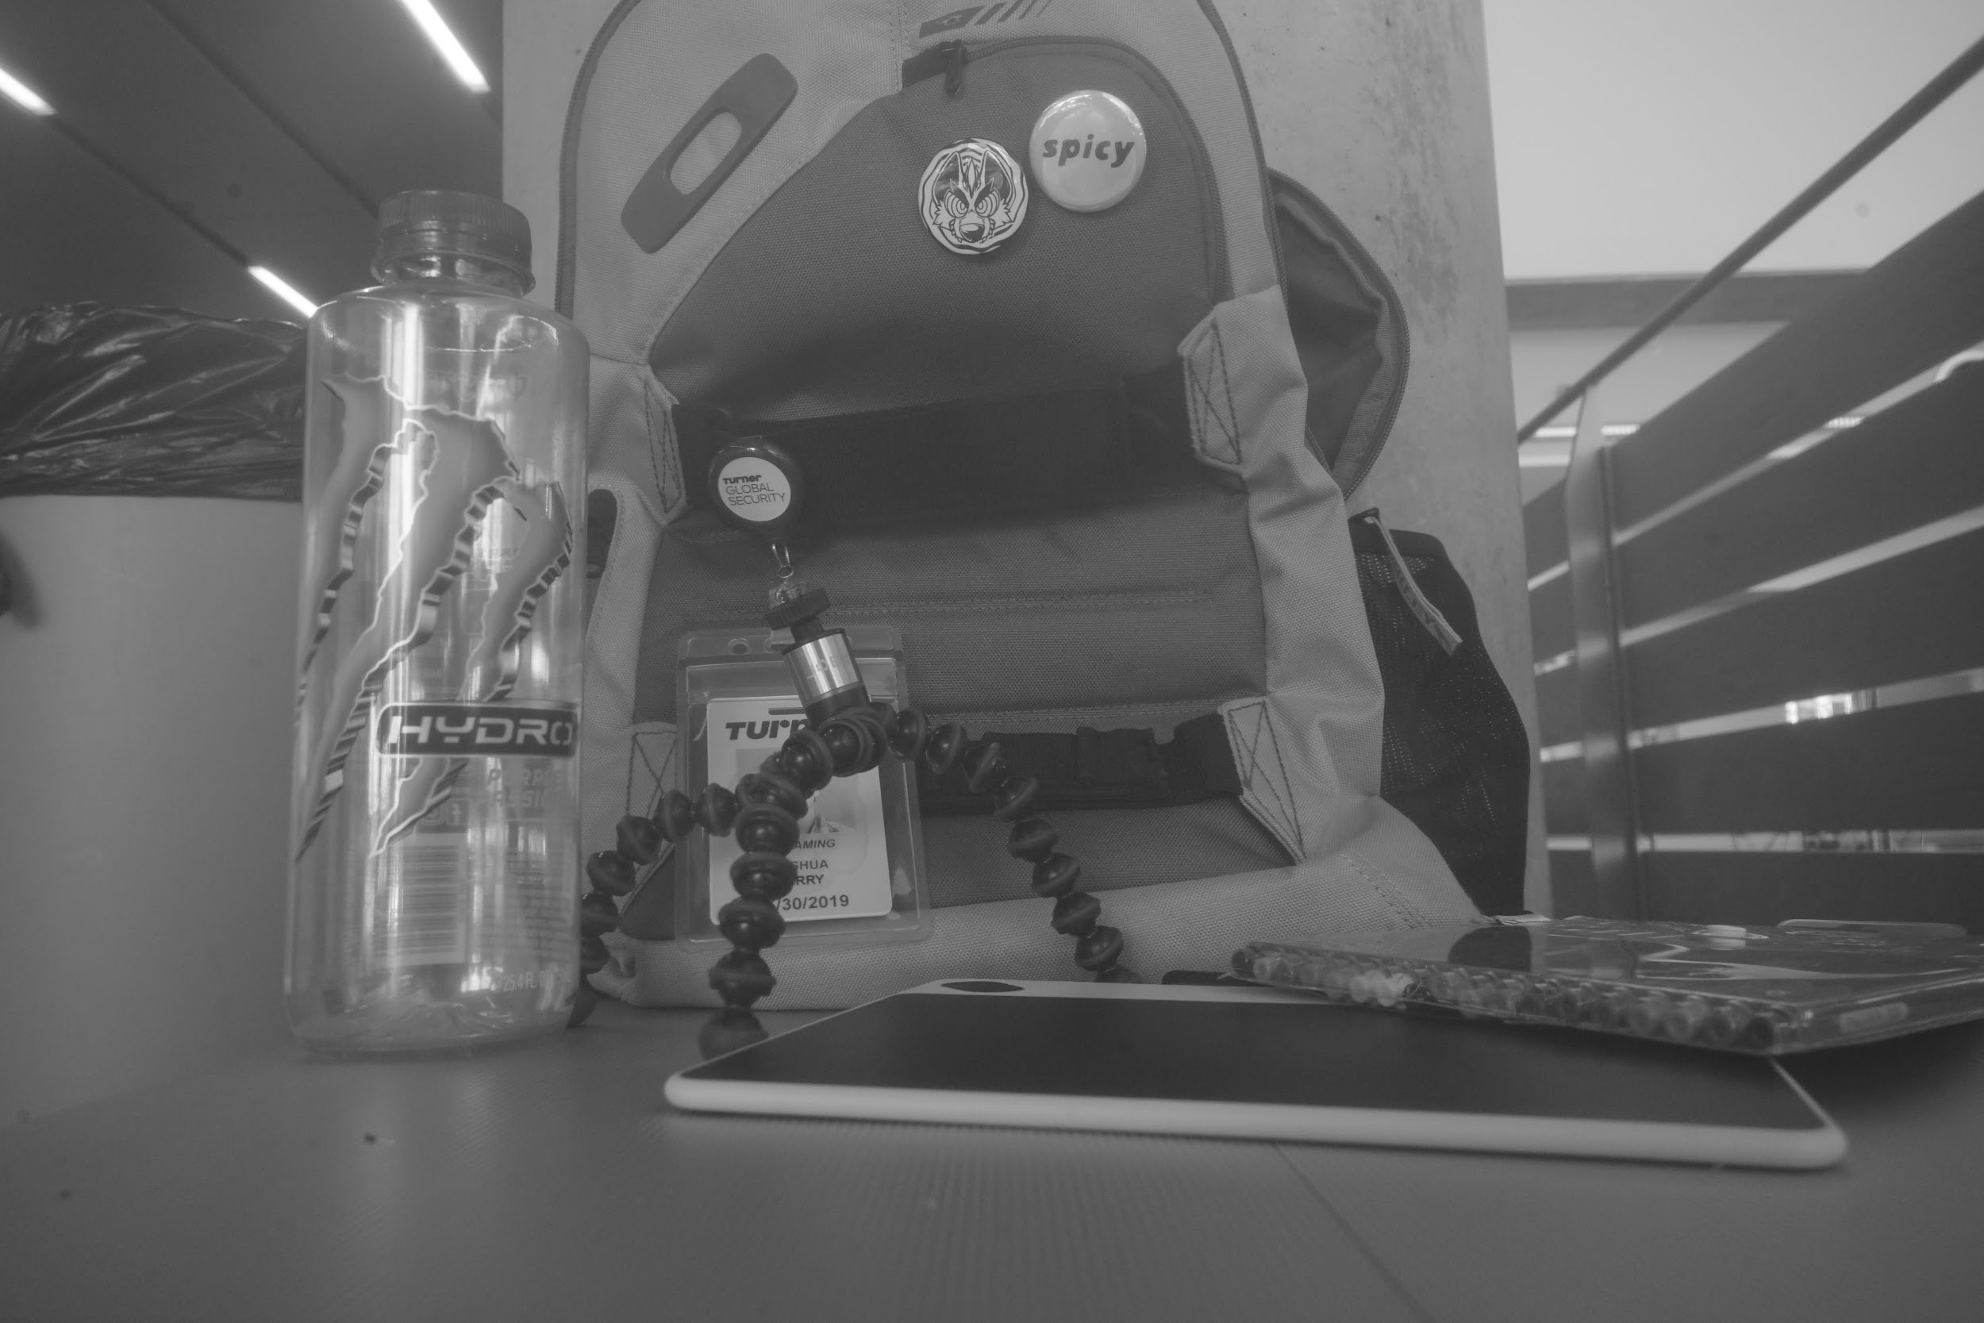
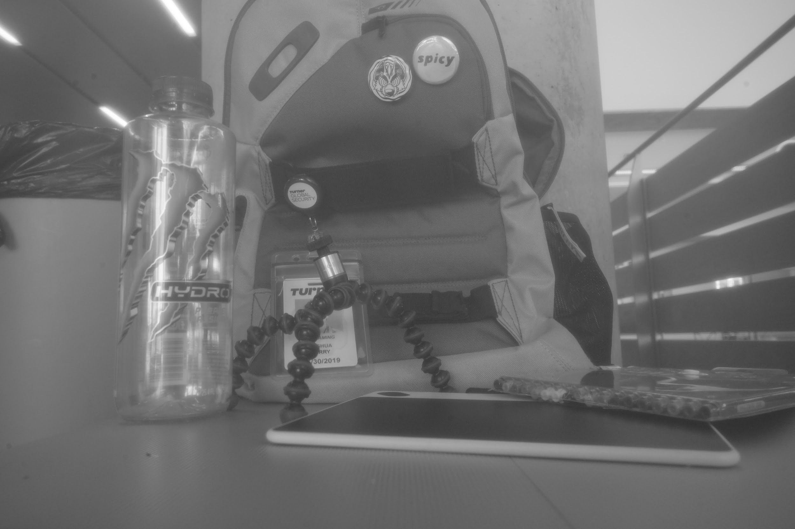
Images: B/W + Static
Finally, we captured black and white images of the same static subject through RGB and CMY filters, mapped those images on to RGB values, and combined to deepen our understanding.

Slide 9
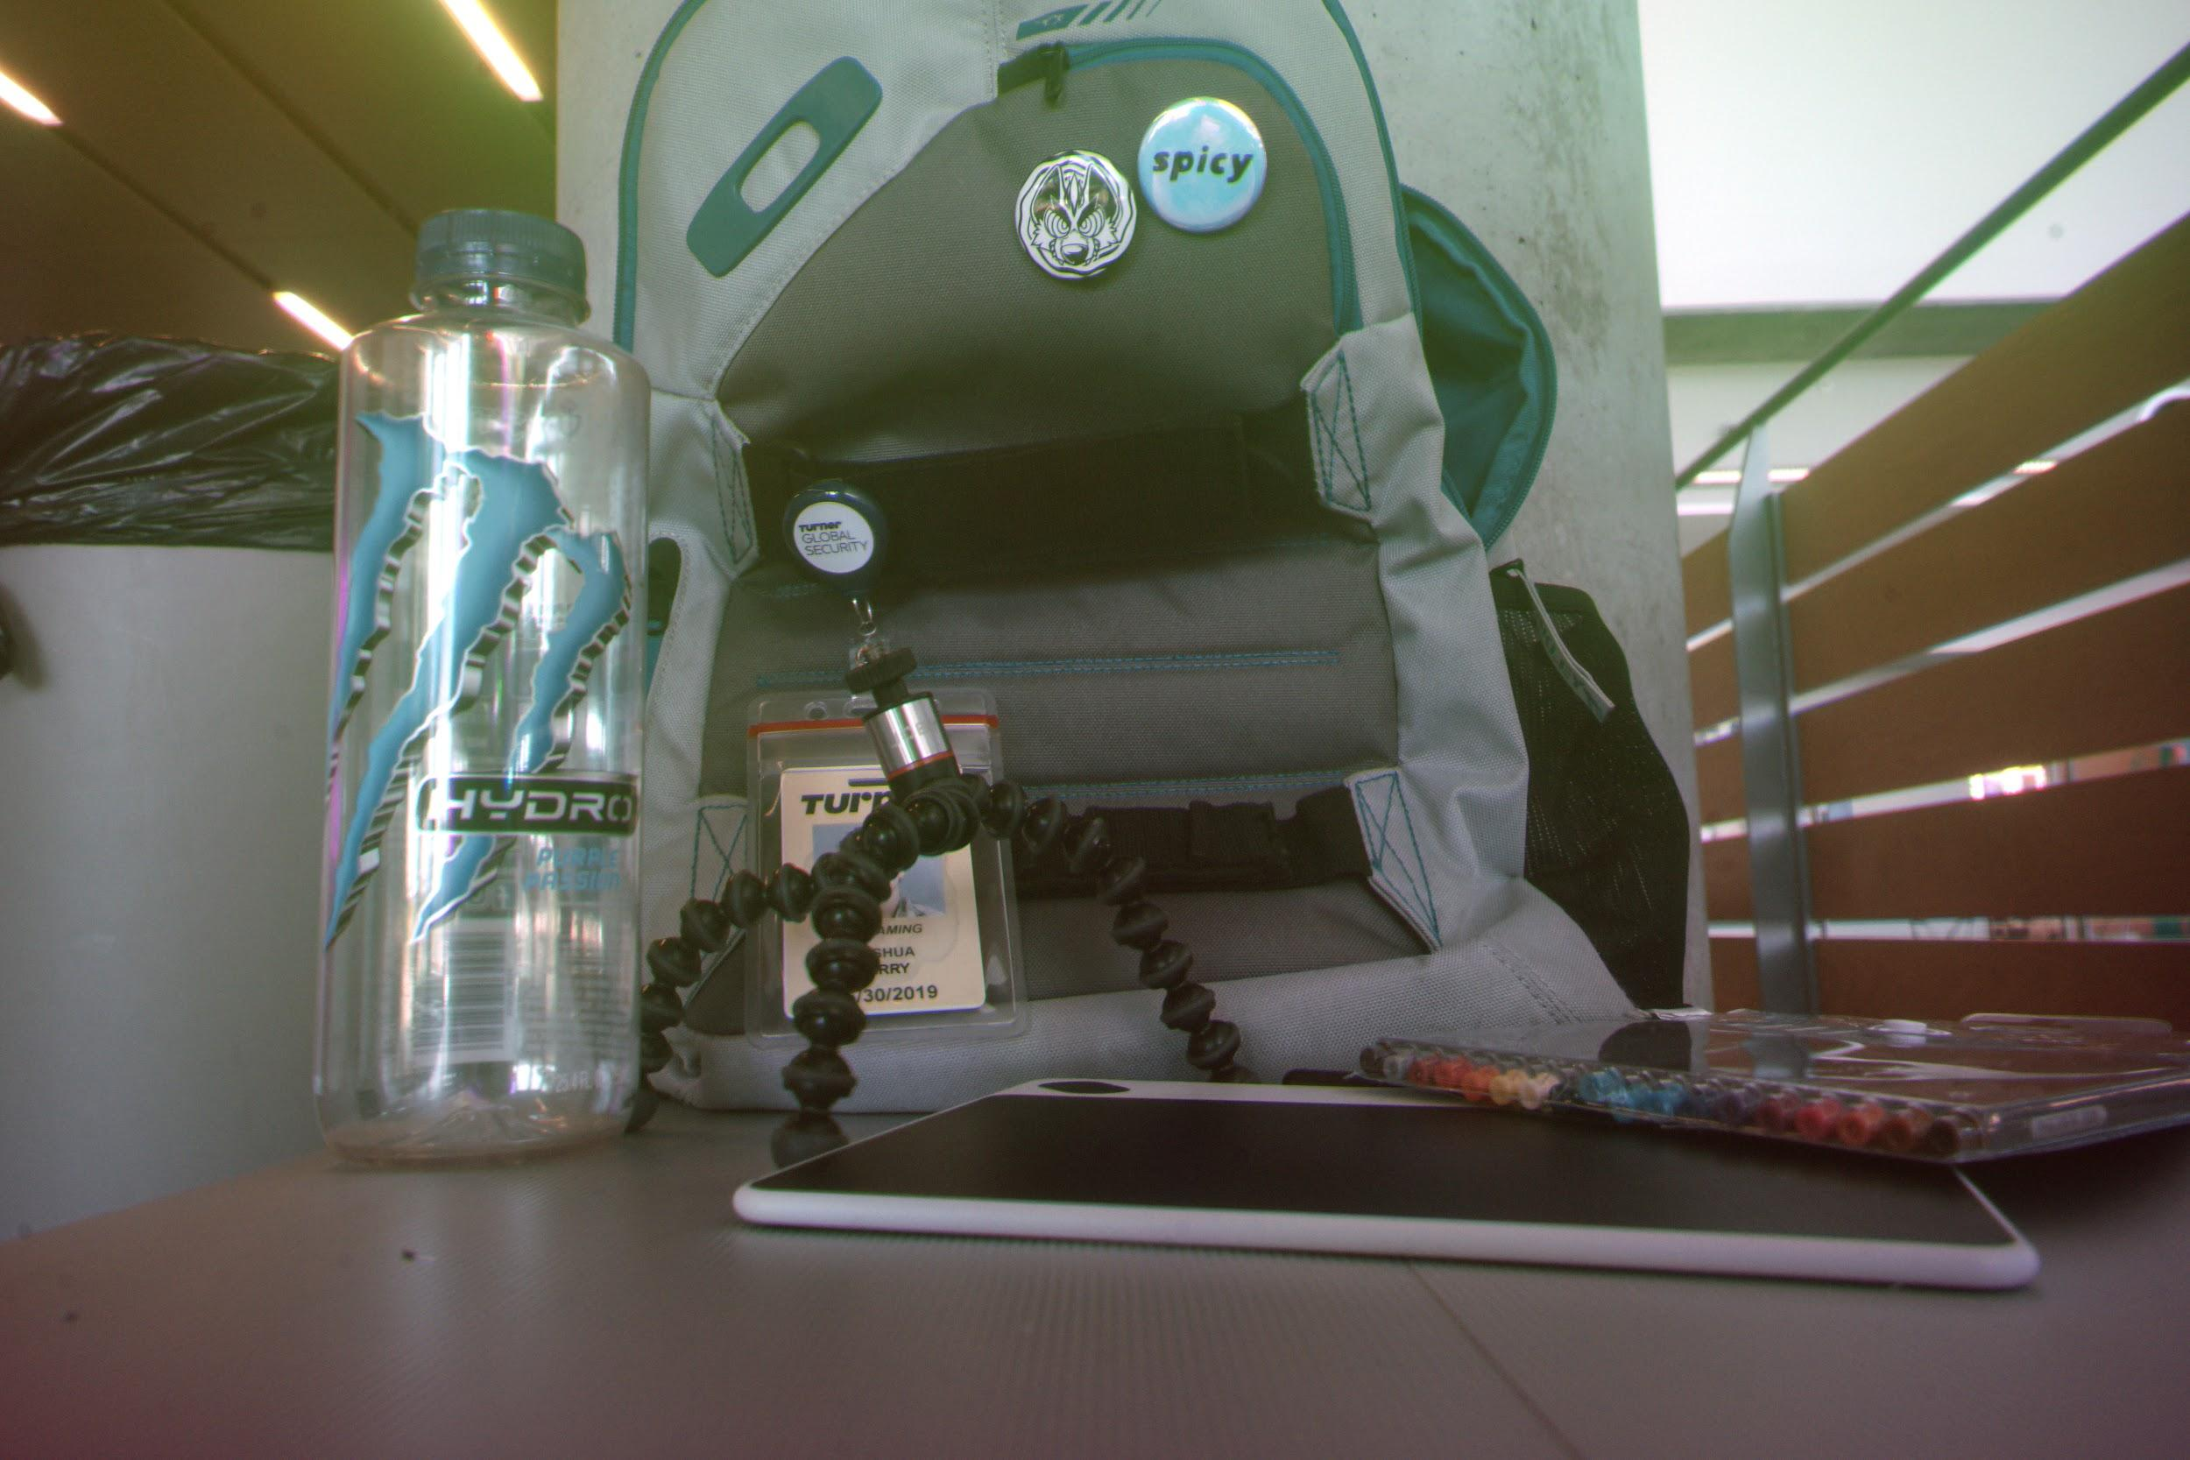
Appears somewhat sepia
Detail lost in superwhite
Previous issues persist

Slide 10
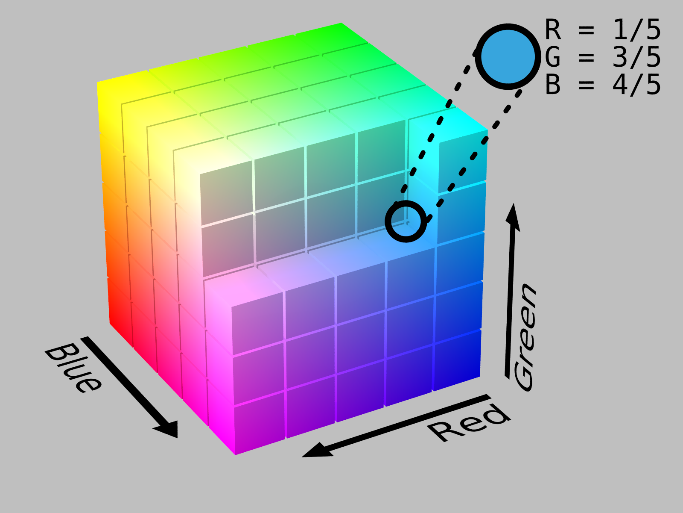
Areas darker or lighter across images (e.g. where people are) gravitate toward opposite corners of the RGB cube, revealing CMYK artifacts within an RGB image. We aim to discover what color artifacts appear in non-RGB photos.
RGB Color Space Cube

Slide 11
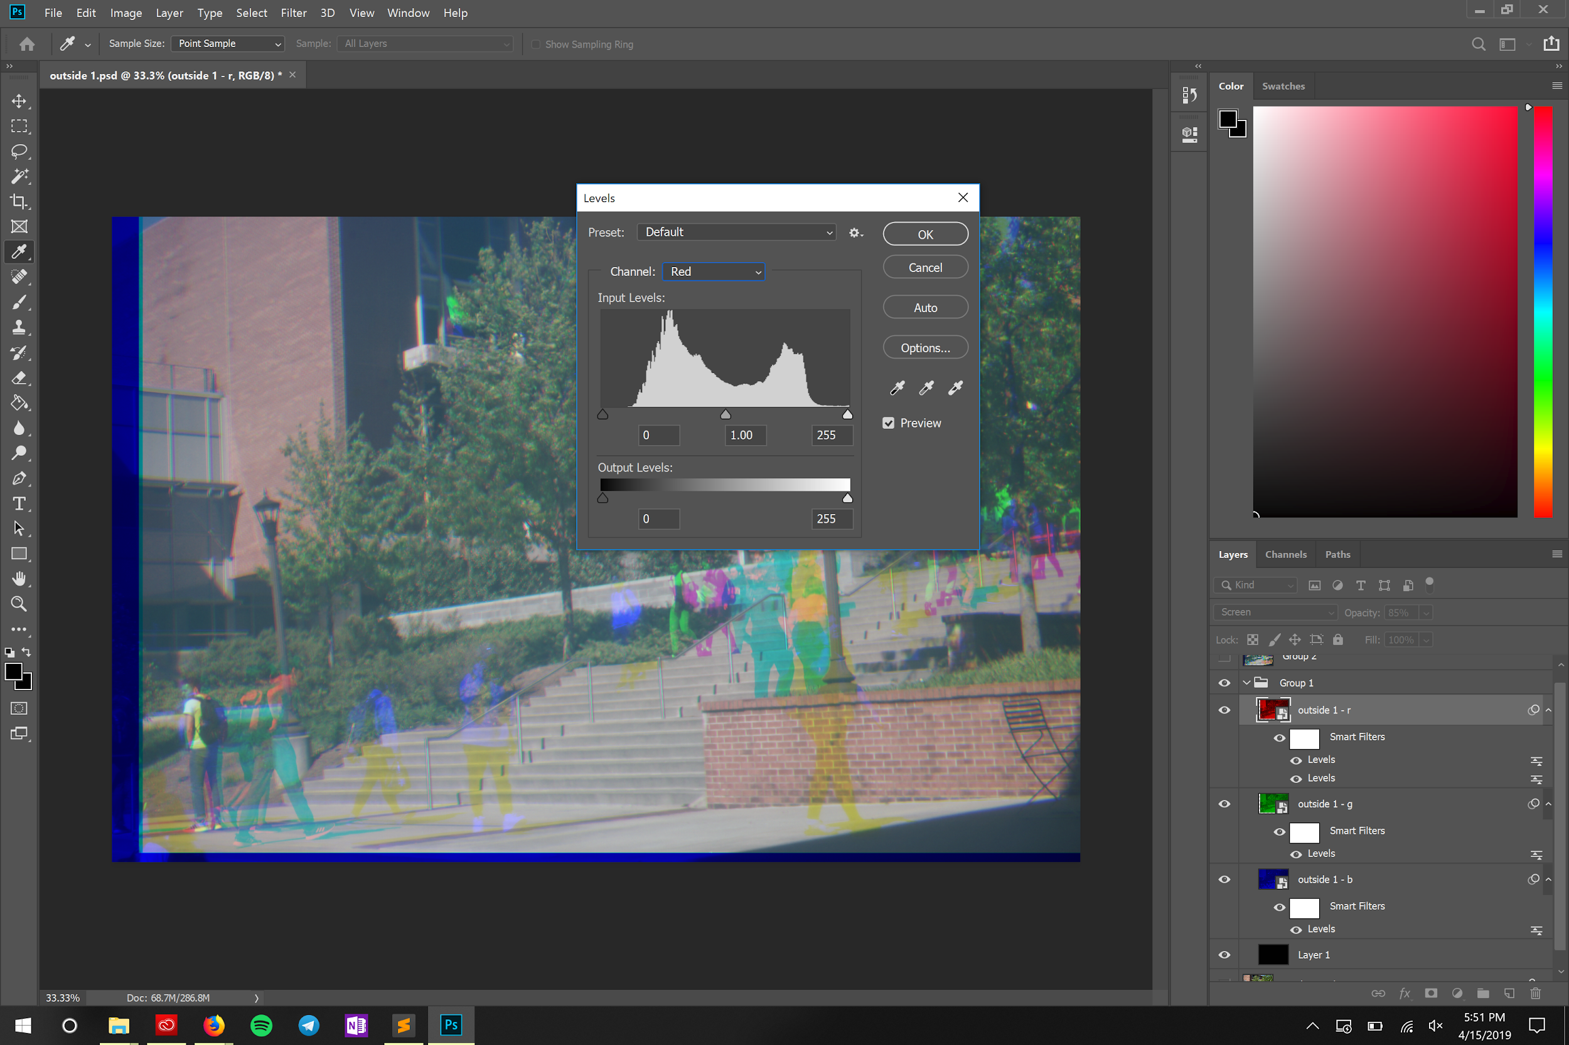
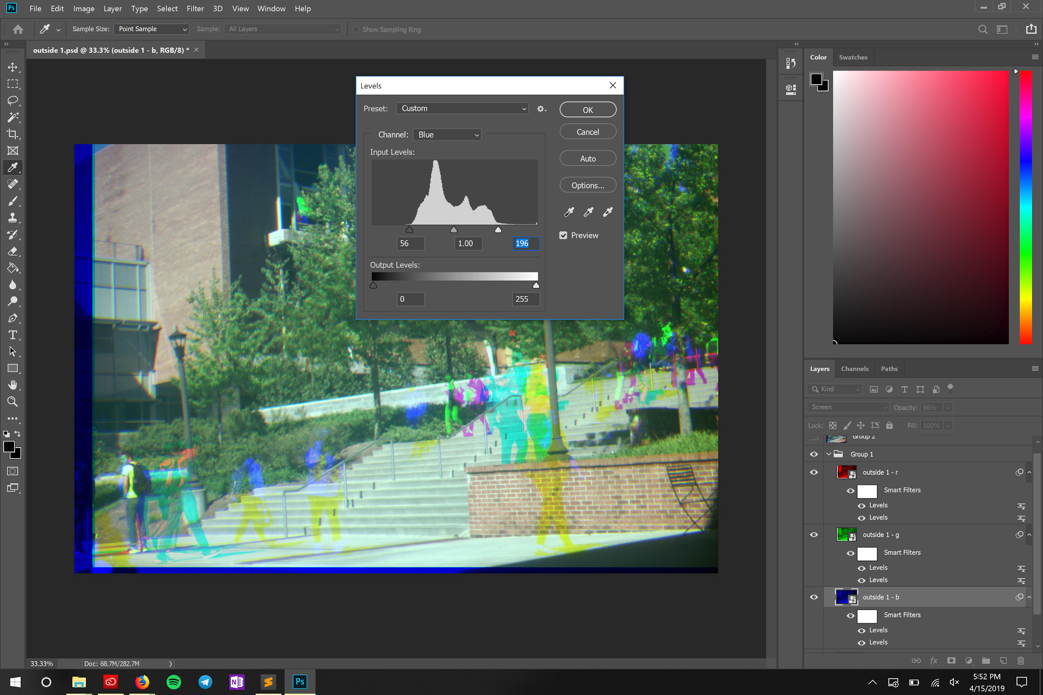
Truncating Invisible Values
After separating RGB photos into their channels, the photos appear gray-ish and washed-out.
This is due to the photos having extremely few pixels with values under 55 or above 200.
To remedy this, we truncate the invisible values and linearly scale the images’ pixels’ values upward to fill a color-rich 0-255 spread.
The image still appears somewhat washed out, but is much more vibrant than before.

Slide 12
Photoshop Takeaways
Ignore all values that do not correspond with the color of a filter used. (e.g. only read red values from a red filter, only blue and green values from a cyan filter, etc.)
Color images shot through filters are generally higher-quality than black and white images shot through the same filters.
Truncate and linearly scale values to fill the 0-255 RGB colorspace of an image for a more aesthetically pleasing image.

Slide 13
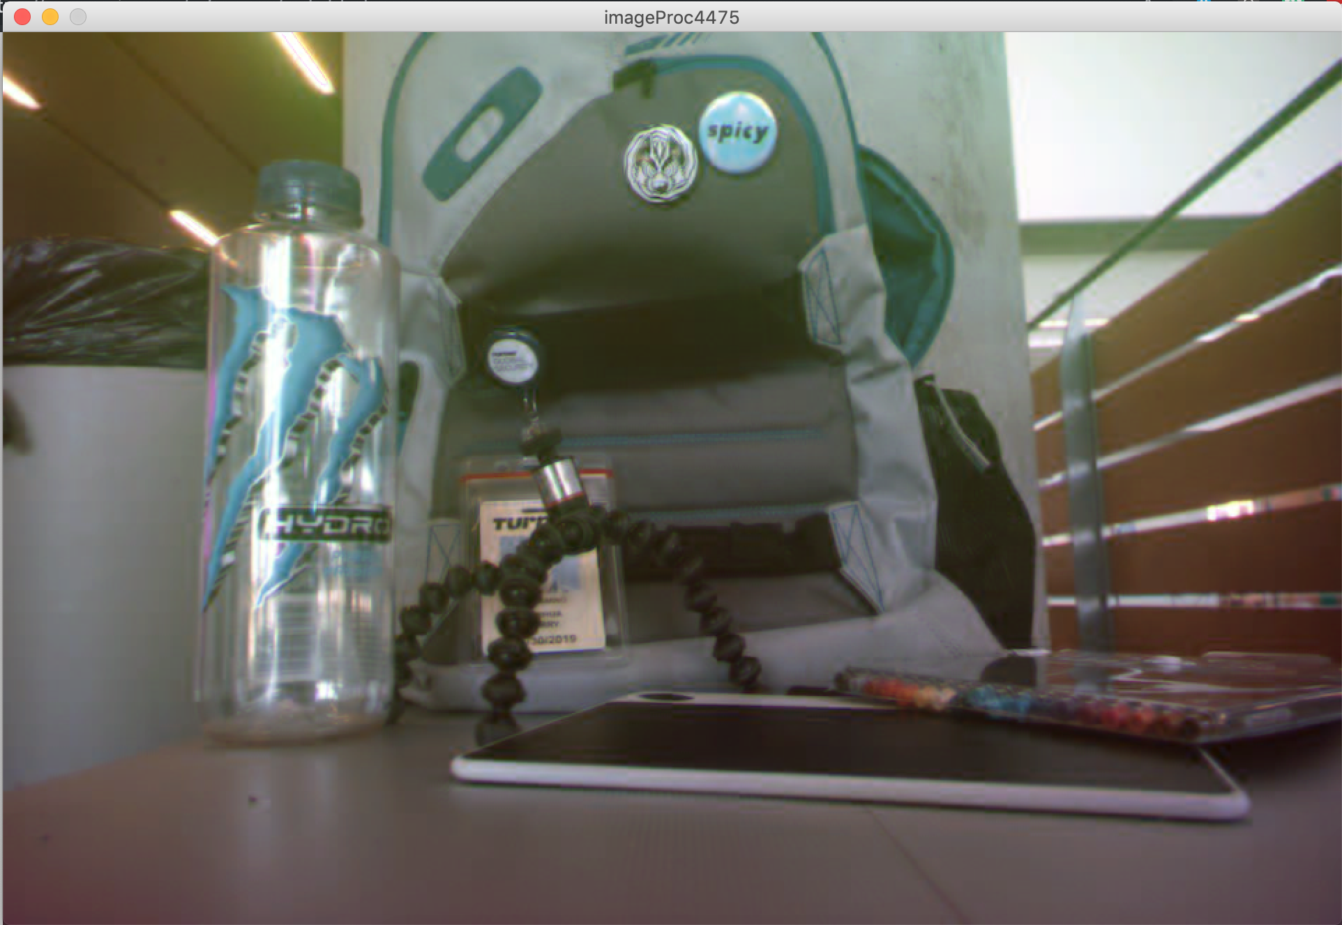
The Program
So far, we have begun to write a program in Processing that enables a user to dynamically add and combine 3 images. We are currently sorting out the math to create an image like those previously featured.
Moving forward, we would like to allow the user to add any number of images to the program, give the user control as to what images map to specific RGB values, and implement a way to save images through the program.

Slide 14
What’s left to do:
Gather more filtered images and further analyze what functionalities within photoshop render the most interesting images
Finalize math to apply to images when analyzing and RGB-mapping them within our program
Implement user-friendly interface including sliders and save functionality

Slide 15
Sources
By SharkD - Own work. Download source code., CC BY-SA 3.0, https://commons.wikimedia.org/w/index.php?curid=9803283
Brown, Evan N. “Images of Old Russia, From a Photography Pioneer.” 28 March 2019. https://www.atlasobscura.com/articles/early-color-photography-russia
Caldwell, Roy L. Department of Integrative Biology, University of California, Berkeley - National Science Foundation [1], Public Domain, https://commons.wikimedia.org/w/index.php?curid=10483908

